Slide 1
Lecture 26
Semaphores I
National University of
Computer & Emerging Sciences

Slide 2
Higher-level synchronization primitives
We have looked at one synchronization primitive: locks
Locks are useful for many things, but sometimes programs have different requirements.

Slide 3
Examples?
We have a shared variable
  any number of threads can read the variable
  but only one thread can write it at a time.
How it can be done using locks?

Slide 4
Reader() {
mycopy = shared_var;
return mycopy;
}
Writer() {
while ( TestAndSet (&lock ));
shared_var = NEW_VALUE;
lock = FALSE;
}
^{What's wrong with this code?}

Slide 5
IPC issues
1. How do the processes communicate?
2. One process should not get into the way of another process when doing critical activities
3. Proper sequence of execution when dependencies are present

Slide 6
IPC issues
  A produces data, B reads it
  Before reading B should wait while A is producing data
  If A and B are sharing a common buffer
  As long as the Buffer is Empty
    B has to wait
    Thus, B is dependent on A
  As long as the Buffer is Full
    A has to wait
    Thus, A is also dependent on B

Slide 7
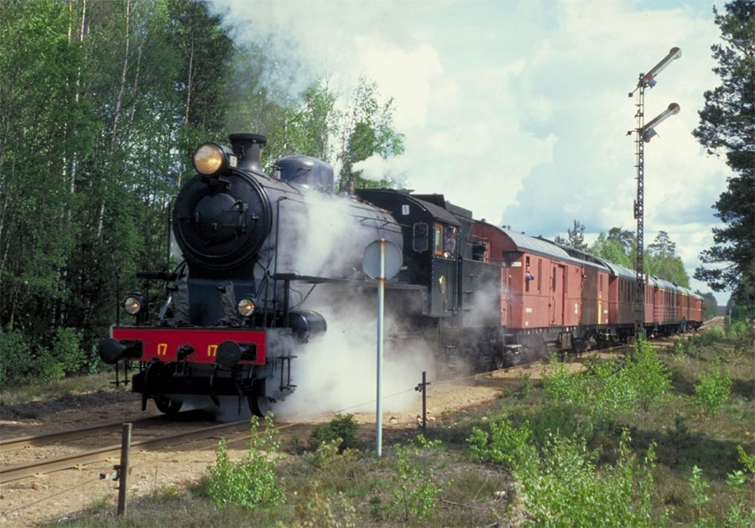
Semaphores
Higher-level synchronization construct
  Designed by Edsger Dijkstra in the1960’s
Semaphore
Notes:
18/02/08

Slide 8
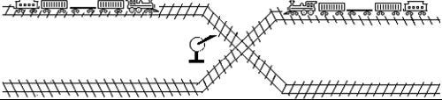
Semaphores
SEMAPHORES

Slide 9
Semaphore
Semaphore S – integer variable, stored in the kernel, shared by processes
Two standard operations modify S: wait() and signal()
  Originally called P() and V()
Less complicated
Can only be accessed via two indivisible (atomic) operations
  wait () / P() {
  while S <= 0; // no-op
  S--;
  }
  An atomic operation that waits for semaphore to become positive
  then decrements it by 1
Atomic
Atomic
  signal () / V() {
  S++;
  }
  An atomic operation that increments semaphore by 1; wakes up a waiting P, if any

Slide 10
How is the atomicity achieved in Uniprocessors ?
P() and V() are implemented as system calls
Thus, interrupt enabling/disabling is save

Slide 11
Semaphores are like integers, except:
1. No negative values
2. Only operations are P and V
Can't read or write value, except to set it initially
3. Operations must be atomic
  Two P's that occur together can't decrement the value below zero.
  Similarly, thread going to sleep in P won't miss wakeup from V, even if they both happen at about the same time.

Slide 12
Two uses of Semaphores
Mutual exclusion
  When semaphores are used for mutual exclusion: “One process in Critical Section”
  Semaphore mutex; // initialized to 1
  do {
  P (mutex);
  // Critical Section
  V (mutex);
  // remainder section
  } while (TRUE);
  wait () / P() {
  while S <= 0; // no-op
  S--;
  }
  signal () / V() {
  S++;
  }

Slide 13

Semaphore as Mutual Exclusion
1
0
P()
V()
Printer Pool
☺
☹
☹
☺
☺
☹
☺

Slide 14
Two uses of Semaphores
Scheduling constraints
  “When a Process is dependent on another process”
  Semaphores provide a way for a thread to wait for something.
For example, you can implement Thread::Join using semaphores:
  Initial value of semaphore = 0
  Parent Process’s waitpid() calls P()
  Child Process’s exit() calls V()

Slide 15
Semaphore for Scheduling Constraints
P()
0
1
0
V()
☹
Consumer
☺
Consumer
☺
Producer
☺
Consumer

Slide 16
Semaphore Implementation with no Busy waiting
With each semaphore there is an associated waiting queue.
Two operations:
  block – place the process invoking the operation on the appropriate waiting queue.
  wakeup – remove one of processes in the waiting queue and place it in the ready queue.

Slide 17
Semaphore P() Implementation
1
Disable Interrupts
0
1
0
Printer Pool
If value > 0
values --;
P()
else
change status from
Run to Block
☺
☹
Sleep:
( Add to Block list
Run another Process)
Enable Interrupts
P()
P() should be atomic
☺

Slide 18
Semaphore V() Implementation
1
0
0
1
Printer Pool
Disable Interrupts
If Block Queue Not Empty
Remove a Process from the Block Queue
Change Status from Block to Ready
V()
values ++;
Enable Interrupts
☺
Running
V() should be atomic
☺
Ready
☹

Slide 19
Binary and Counting Semaphores
There are two kinds of Semaphores:
  Binary semaphores
    Control access to a single resource, taking the value of 0 (resource is in use) or 1 (resource is available).
  Counting semaphores
    Control access to multiple resources, thus assuming a range of nonnegative values.

Slide 20
Binary and Counting Semaphores
The real value of semaphores becomes apparent when the counter can be initialized to a value other than 0 or 1.
Say we initialize a semaphore's counter to 50.
  What does this mean about P() and V() operations?
Notes:
18/02/08

Slide 21
Semaphore
P()
P()
V()
P()
P()
P()
P()
3
2
1
0
☺
Printer Pool
☺
☺
☹
☹
☺
☺
☹
☺

Slide 22
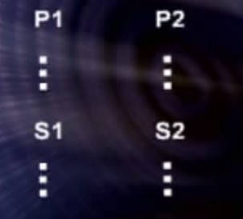
Process Synchronization

